Slide 1

WEB PROGRAMMING AND APPLICATIONS
COURSE CODE: 503073 LECTURERS: NGUYEN NGOC PHIEN GROUP: 04

Slide 2
TABLE OF CONTENTS
01
02
03
Form Data Handling: GET and POST methods, form data security.
Sessions and Cookies Management: Usage and security aspects.
String, Time, and Date Handling: String functions, working with dates and times.

Slide 3
01
Form Data Handling

Slide 4
1.1 GET METHOD
Client sends: The GET method sends form data appended to the URL as query parameters. When using the GET method, the submitted data is visible in the browser's address bar and can be bookmarked. This method is suitable for simple and non-sensitive data, such as search queries.
For example: With the URL tdtu.edu?id=12, the Server will receive the value id = 12
Server receives data: All data that the Client sends using the GET method is stored in a global variable that PHP creates itself is the $_GET variable, this variable is an associative array type that stores a list of data sent from the client according to the rule key => value.
For example: With the URL tdtu.edu?id=12, the key is “id” and the value is “12”

Slide 5
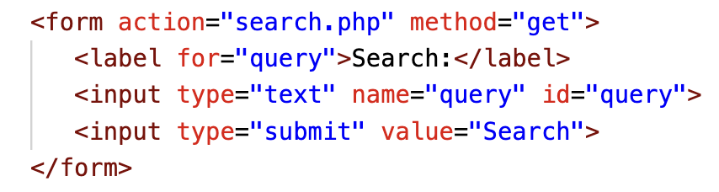
1.1 GET METHOD
Here's an example of a form using the GET method:

Slide 6
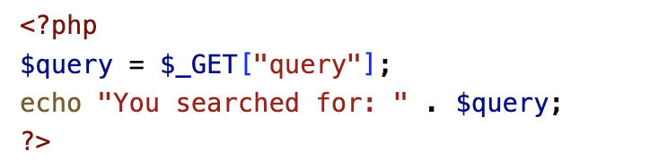
1.1 GET METHOD
In your PHP script (search.php), you can access the GET data using the $_GET superglobal array:

Slide 7
1.2 POST METHOD
Client sends: The POST method sends form data in the request's body, making it invisible in the browser's address bar. This method is suitable for handling sensitive data, such as login credentials, and for submitting large amounts of data.
Server receives data: All data sent using the POST method is stored in a global variable $_POST created by PHP itself.

Slide 8
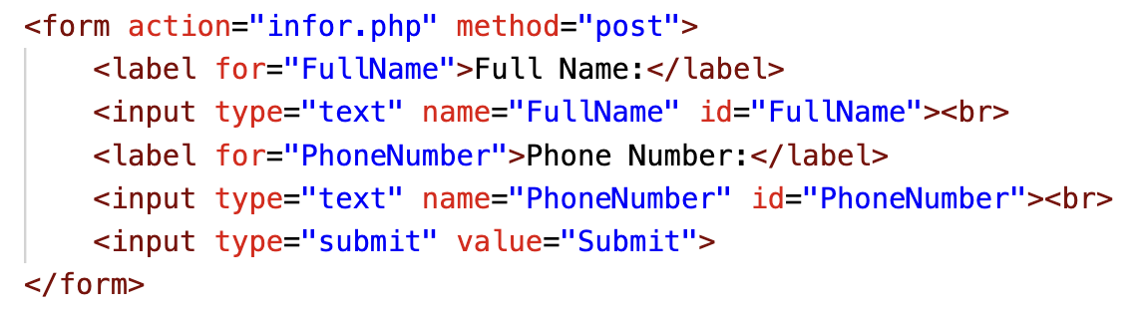
1.2 POST METHOD
Here's an example of a form using the POST method:

Slide 9
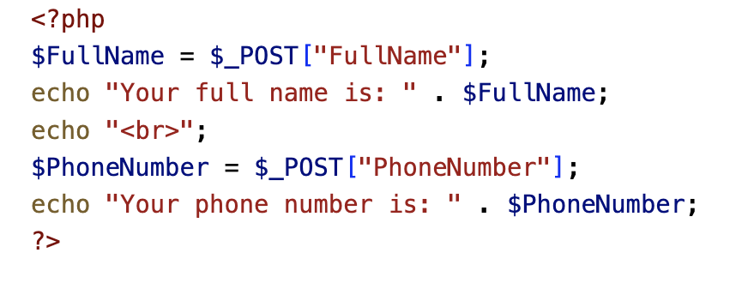
1.2 POST METHOD
In your PHP script (infor.php), you can access the POST data using the $_POST superglobal array:

Slide 10
DIFFERENCES BETWEEN GET AND POST
1. Visibility
When using GET, data parameters are included in the URL and visible to everyone. However, when using POST, data is not displayed in the URL but in the HTTP message body.
2. Security
GET is less secure because the URL contains part of the data sent. On the other hand, POST is safer because the parameters are not stored in web server logs or the browser history.

Slide 11
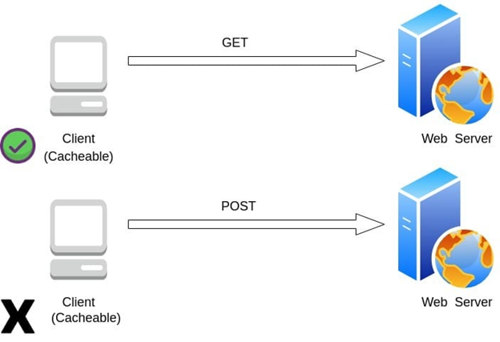
DIFFERENCES BETWEEN GET AND POST
3. Cache
GET requests can be cached and remain in the browser history, while POST requests cannot. This means GET requests can be bookmarked, shared, and revisited, while POST requests cannot:

Slide 12
DIFFERENCES BETWEEN GET AND POST
4. Sever State
GET requests are intended to retrieve data from a server and do not modify the server’s state. On the other hand, POST requests are used to send data to the server for processing and may modify the server’s state.
5. Amount of Data Transmitted
The GET method is limited to a maximum number of characters, while the POST method has no such limitation. This is because the GET method sends data through the resource URL, which is limited in length, while the POST method sends data through the HTTP message body, which has no such limitation.
6. Data Type
The GET method supports only string data types, while the POST method supports different data types such as string, numeric, binary, and so on.

Slide 13
1.3 VALIDATING FORM DATA
1.3.1 Required fields
Within the context of PHP and form validation, required fields refer to input fields that must be filled out before the form can be submitted. This is often implemented using the 'empty()' function in PHP to check if a field has been left blank. If a required field is empty upon form submission, an error message is typically displayed to the user.
To make a form field required, you can use the empty() function to check if the submitted value is empty. If it is, display an error message and prevent form submission.

Slide 14
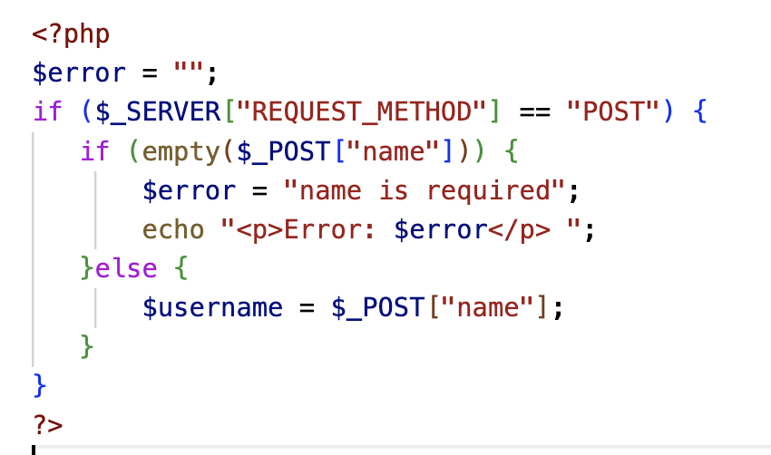

1.3 VALIDATING FORM DATA
Here's an example of validating required fields:
The error will be sent is:

Slide 15
1.3 VALIDATING FORM DATA
1.3.2 Sanitizing input data
In PHP and web development, sanitizing input data is a crucial process that cleanses user-submitted data to prevent potential security risks such as SQL injection or cross-site scripting (XSS) attacks. This is typically done using built-in PHP functions like ‘htmlspecialchars()’ and ‘strip_tags()’ to remove or encode harmful characters.
Sanitizing input data is essential to prevent security vulnerabilities, such as cross-site scripting (XSS) attacks. You can use the htmlspecialchars() function to convert special characters to HTML entities

Slide 16
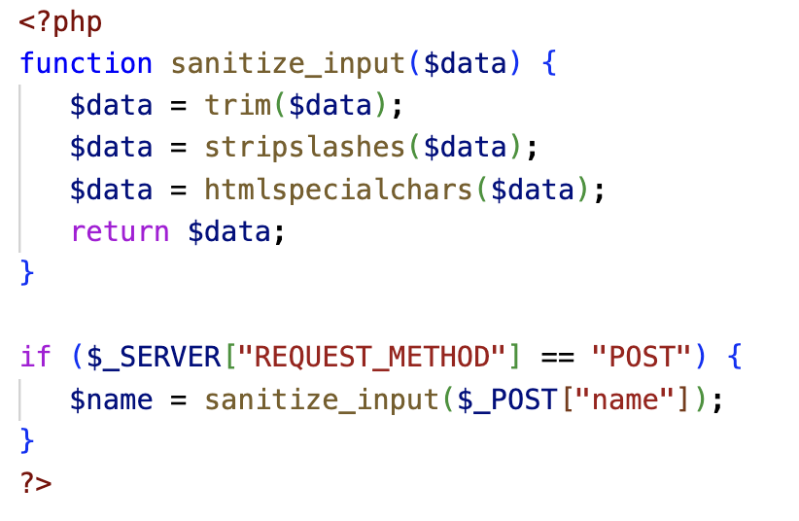
1.3 VALIDATING FORM DATA
Here's an example of sanitizing input data:

Slide 17
1.3 VALIDATING FORM DATA
1.3.3 Validating specific input types
Validating specific input types in PHP involves applying specific validation rules to certain types of user-submitted data. This includes checking if an email address is in the correct format using 'filter_var()' with 'FILTER_VALIDATE_EMAIL', or checking if a URL is valid using 'filter_var()' with 'FILTER_VALIDATE_URL'. This helps ensure that the data received matches the expected format and criteria.
You can use PHP's built-in functions to validate specific input types, such as email addresses and URLs.

Slide 18
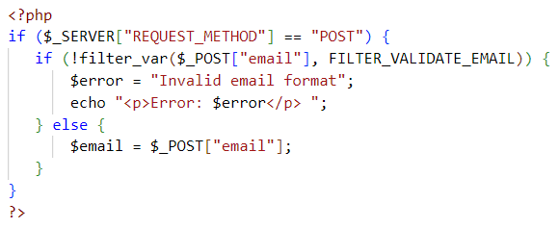
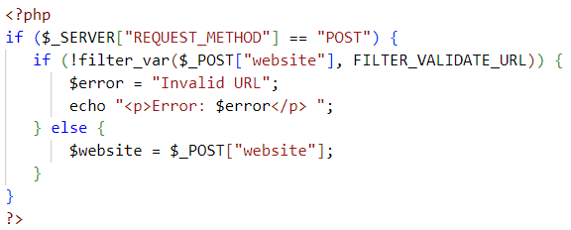


1.3 VALIDATING FORM DATA
1.3.3 Validating specific input types
Here's an example of validating specific input types:
Email:
URL:
The error will be sent is:
The error will be sent is:

Slide 19
02
Sessions and Cookies Management

Slide 20
WHAT IS COOKIE?
A cookie is a small file with the maximum size of 4KB that the web server stores on the client computer.
Once a cookie has been set, all page requests that follow return the cookie name and value.
A cookie can only be read from the domain that it has been issued from. For example, a cookie set using the domain stdportal.tdtu.edu.vn can not be read from the domain lichhoc-lichthi.tdtu.edu.vn
Most of the websites on the internet display elements from other domains such as advertising. The domains serving these elements can also set their own cookies. These are known as third party cookies.
A cookie created by a user can only be visible to them. Other users cannot see its value.
Most web browsers have options for disabling cookies, third party cookies or both.
If this is the case then PHP responds by passing the cookie token in the URL.

Slide 21
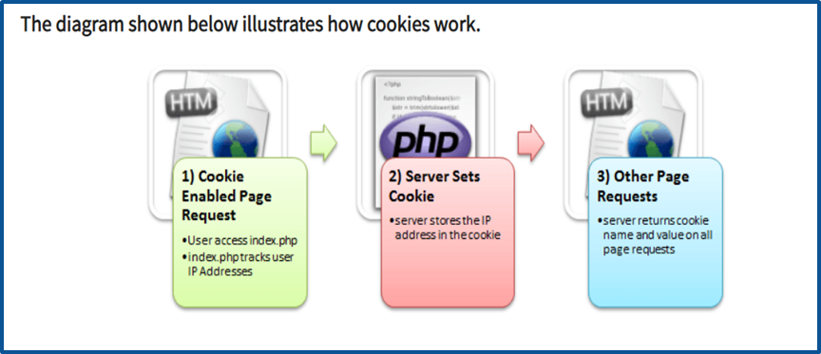
A user requests for a page that stores cookies.
The server sets the cookie on the user’s computer.
Other page requests from the user will return the cookie name and value.

Slide 22
WHY AND WHEN TO USE COOKIES?
Http is a stateless protocol; cookies allow us to track the state of the application using small files stored on the user’s computer. The path were the cookies are stored depends on the browser. Internet Explorer usually stores them in Temporary Internet Files folder.
Personalizing the user experience – this is achieved by allowing users to select their preferences. The page requested that follow are personalized based on the set preferences in the cookies.
Tracking the pages visited by a user

Slide 23
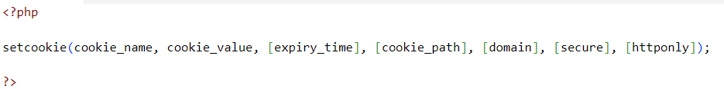
CREATING COOKIES
Let’s now look at the basic syntax used to create a cookie.

Slide 24
CREATING COOKIES
Php“setcookie” is the PHP function used to create the cookie.
“cookie_name” is the name of the cookie that the server will use when retrieving its value from the $_COOKIE array variable. It’s mandatory.
“cookie_value” is the value of the cookie and its mandatory
“[expiry_time]” is optional; it can be used to set the expiry time for the cookie such as 1 hour. The time is set using the PHP time() functions plus or minus a number of seconds greater than 0 i.e. time() + 3600 for 1 hour.
“[cookie_path]” is optional; it can be used to set the cookie path on the server. The forward slash “/” means that the cookie will be made available on the entire domain. Sub directories limit the cookie access to the subdomain.
“[domain]” is optional, it can be used to define the cookie access hierarchy i.e. www.cookiedomain.com means entire domain while www.sub.cookiedomain.com limits the cookie access to www.sub.cookiedomain.com and its sub domains. Note it’s possible to have a subdomain of a subdomain as long as the total characters do not exceed 253 characters.
“[secure]” is optional, the default is false. It is used to determine whether the cookie is sent via https if it is set to true or http if it is set to false.
“[Httponly]” is optional. If it is set to true, then only client side scripting languages i.e. JavaScript cannot access them.
Note: The php set cookie function must be executed before the HTML opening tag.

Slide 25

CREATING COOKIES
Let’s now look at an example that uses cookies.
We will create a basic program that allows us to store the user name in a cookie that expires after ten seconds.
The code below shows the implementation of the above example “cookies.php”.
Output:

Slide 26

RETRIEVING THE COOKIE VALUE
Create another file named “cookies_read.php” with the following code.
Output:
Array ( [Phpstorm-5b3b1f8e] => 097b0d09-a417-4ddb-a7f8-2ba21bd21ff3 [PHPSESSID] => maihisk01g90o12394b9knchfu [user_name] => Thanhnhan123 )
Note: $_COOKIE is a PHP built in super global variable.
It contains the names and values of all the set cookies.
The number of values that the $_COOKIE array can contain depends on the memory size set in php.ini.
The default value is 1GB. Testing our application.

Slide 27
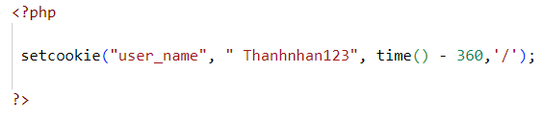
DELETE COOKIES
If you want to destroy a cookie before its expiry time, then you set the expiry time to a time that has already passed.
Create a new file named cookie_destroy.php with the following code

Slide 28
WHAT IS A SESSION?
A session is a global variable stored on the server.
Each session is assigned a unique id which is used to retrieve stored values.
Whenever a session is created, a cookie containing the unique session id is stored on the user’s computer and returned with every request to the server. If the client browser does not support cookies, the unique php session id is displayed in the URL
Sessions have the capacity to store relatively large data compared to cookies.
The session values are automatically deleted when the browser is closed. If you want to store the values permanently, then you should store them in the database.
Just like the $_COOKIE array variable, session variables are stored in the $_SESSION array variable. Just like cookies, the session must be started before any HTML tags.

Slide 29
WHY AND WHEN TO USE SESSIONS?
You want to store important information such as the user id more securely on the server where malicious users cannot temper with them.
You want to pass values from one page to another.
You want the alternative to cookies on browsers that do not support cookies.
You want to store global variables in an efficient and more secure way compared to passing them in the URL.
You are developing an application such as a shopping cart that has to temporary store information with a capacity larger than 4KB.

Slide 30
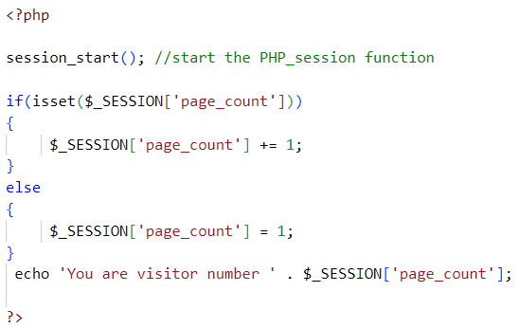

CREATING A SESSION
In order to create a session, you must first call the PHP session_start function and then store your values in the $_SESSION array variable.
Let’s suppose we want to know the number of times that a page has been loaded, we can use a session to do that.
The code below shows how to create and retrieve values from sessions
Output:

Slide 31
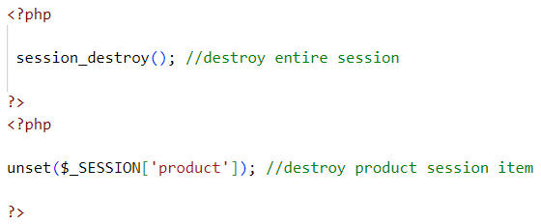
DESTROYING SESSION VARIABLES
The session_destroy() function is used to destroy the whole Php session variables.
If you want to destroy only a session single item, you use the unset() function.
The code below illustrates how to use both methods.
Session_destroy removes all the session data including cookies associated with the session.
Unset only frees the individual session variables.
Other data remains intact.

Slide 32
SUMMARY
Cookies are small files saved on the user’s computer.
Cookies can only be read from the issuing domain.
Cookies can have an expiry time, if it is not set, then the cookie expires when the browser is closed.
Sessions are like global variables stored on the server.
Each session is given a unique identification id that is used to track the variables for a user.
Both cookies and sessions must be started before any HTML tags have been sent to the browser.

Slide 33

03
String, Time, and Date Handling

Slide 34
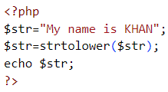

PHP STRING FUNCTIONS
PHP provides various string functions to access and manipulate strings.
1. PHP strtolower() function
The strtolower() function returns string in lowercase letter.
Syntax:
string strtolower (string $string)
Example
Output:

Slide 35
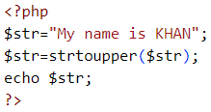

PHP STRING FUNCTIONS
2. PHP strtoupper() function
The strtoupper() function returns string in uppercase letter.
Syntax:
string strtoupper (string $string)
Example
Output:

Slide 36
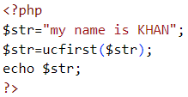

PHP STRING FUNCTIONS
3. PHP ucfirst() function
The ucfirst() function returns string converting first character into uppercase. It doesn't change the case of other characters.
Syntax:
string ucfirst (string $str)
Example
Output:

Slide 37
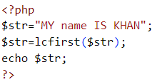

PHP STRING FUNCTIONS
4. PHP lcfirst() function
The lcfirst() function returns string converting first character into lowercase. It doesn't change the case of other characters.
Syntax:
string lcfirst (string $str)
Example
Output:

Slide 38
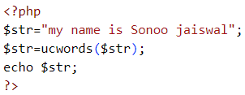
PHP STRING FUNCTIONS
5. PHP ucwords() function
The ucwords() function returns string converting first character of each word into uppercase.
Syntax:
string ucwords (string $str)
Example
Output:

Slide 39
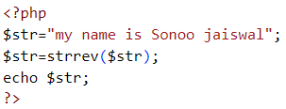
PHP STRING FUNCTIONS
6. PHP strrev() function
The strrev() function returns reversed string.
Syntax:
string strrev (string $string)
Example
Output:

Slide 40
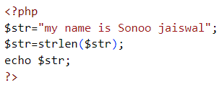

PHP STRING FUNCTIONS
7. PHP strlen() function
The strlen() function returns length of the string.
Syntax:
int strlen (string $string)
Example
Output:

Slide 41
PHP DATE AND TIME
The PHP date() function is used to format a date and/or a time.
The PHP Date() Function
The PHP date() function formats a timestamp to a more readable date and time.
Syntax:
date(format,timestamp)
Parameter | Description
format | Required. Specifies the format of the timestamp
timestamp | Optional. Specifies a timestamp. Default is the current date and time

Slide 42
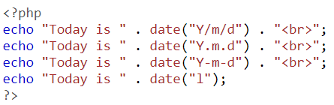
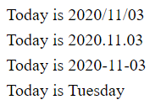
PHP DATE AND TIME
Get a Date
The required format parameter of the date() function specifies how to format the date (or time).
Here are some characters that are commonly used for dates:
d - Represents the day of the month (01 to 31)
m - Represents a month (01 to 12)
Y - Represents a year (in four digits)
l (lowercase 'L') - Represents the day of the week
Other characters, like"/", ".", or "-" can also be inserted between the characters to add additional formatting.
The example below formats today's date in three different ways:
Output:

Slide 43
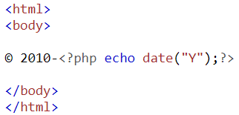

PHP DATE AND TIME
PHP Tip - Automatic Copyright Year
Use the date() function to automatically update the copyright year on your website:
Example:
Output:

Slide 44


PHP DATE AND TIME
Get a Time
Here are some characters that are commonly used for times:
H - 24-hour format of an hour (00 to 23)
h - 12-hour format of an hour with leading zeros (01 to 12)
i - Minutes with leading zeros (00 to 59)
s - Seconds with leading zeros (00 to 59)
a - Lowercase Ante meridiem and Post meridiem (am or pm)
The example below outputs the current time in the specified format:
Output:

Slide 45
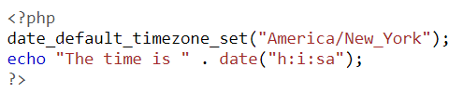

PHP DATE AND TIME
Get Your Time Zone
If the time you got back from the code is not correct, it's probably because your server is in another country or set up for a different timezone.
So, if you need the time to be correct according to a specific location, you can set the timezone you want to use.
The example below sets the timezone to "America/New_York", then outputs the current time in the specified format:
Output:

Slide 46
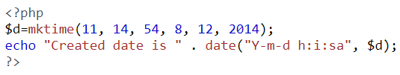

PHP DATE AND TIME
Create a Date With mktime()
The optional timestamp parameter in the date() function specifies a timestamp. If omitted, the current date and time will be used (as in the examples above).
The PHP mktime() function returns the Unix timestamp for a date. The Unix timestamp contains the number of seconds between the Unix Epoch (January 1 1970 00:00:00 GMT) and the time specified.
Syntax:
mktime(hour, minute, second, month, day, year)
The example below creates a date and time with the date() function from a number of parameters in the mktime() function:
Output:

Slide 47


PHP DATE AND TIME
Create a Date From a String With strtotime()
The PHP strtotime() function is used to convert a human readable date string into a Unix timestamp
(the number of seconds since January 1 1970 00:00:00 GMT).
Syntax:
strtotime(time, now)
The example below creates a date and time from the strtotime() function:
Output:
However, strtotime() is not perfect, so remember to check the strings you put in there.

Slide 48
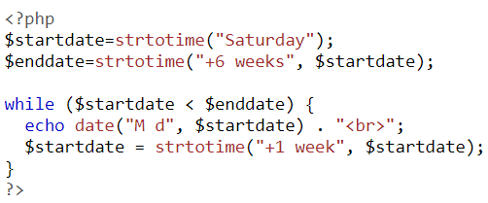

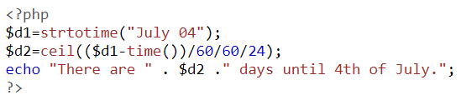

PHP DATE AND TIME
More Date Examples
The example below outputs the dates for the next six Saturdays:
Output:
The example below outputs the number of days until 4th of July:
Output:

Slide 49
What method is commonly used to send passwords such as passwords from the client to the server?
A. RECEIVE
B. POST
C. DELETE
D. SET
B. POST

Slide 50
What are cookies used for in session management?
A. Store user information
A. Store user information B. Send email C. Data encryption D. Create database

Slide 51
Which function in PHP is used to get the length of a string?
A. len()
B. strlen()
C. length()
D. strlength()
B. strlen()

Slide 52
Where will data sent using the GET method appear?
A. In the header of the HTTP request
B. In the body of the HTTP request
C. In the URL of the HTTP request
D. In the cookies of the HTTP request
C. In the URL of the HTTP request

Slide 53
Which function in PHP is used to compare two strings?
A. compare()
B. strcmp()
C. strcomp()
D. compstr()
B. strcmp()

Slide 54
THANK YOU FOR LISTENING ❤

